Slide 1
LETTER & NUMBER SERIES

Slide 2

Types of Number Series There are many types of number series. A few of them are explained below,
Arithmetic Series:
Example: 5, 10, 17, 26, 37, 50, 65

Slide 3

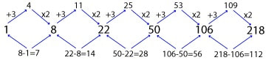
Geometric Series:
Example: 4, 12, 36, 108, 324, 972
Arithmetic-Geometric Series:
Example: 1, 8, 22, 50, 106, 218

Slide 4


Product series:
Example: 2, 4, 8, 16, 32, 64, 128
Mixed series:
Example: 61, 72, 60, 73, 59, 74, 58, 75

Slide 5
Number Series
1. Find the next term of the series 21,26,23,28,25,30,?
A) 21 B) 29 C) 27 D) 33
Notes:
Difficulty level: Easy (Compulsory)
Correct Option C
Alternate Series

Slide 6
Number Series
2. Find the next term of the series 1,9,29,67,?
A) 85 B) 115 C) 129 D) 155
Notes:
Difficulty level: Easy
Correct Option: C
Explanation:- 1^3+0
2^3+1
3^3+2
4^3+3
5^3+4

Slide 7
Number Series
3. Find the next term of the series: 49,216,625,1024,729,?
A) 512 B) 256 C) 128 D) 324
Notes:
Difficulty level: Easy (Compulsory)
Correct Option: C
7^2 , 6^3 , 5^4, 4^5, 3^6 , 2^7

Slide 8
Number Series
4. Find the next term of the series: 7,16,51,208,?
A) 985 B) 1045 C) 1095 D) 1165
Notes:
Difficulty level: Moderate (Compulsory)
Correct Option: B
7*2 + 2=16
16*3 + 3 = 51

Slide 9
Number Series
5. Find the next term of the series: 8,4.5,5.5,13,56,?
A) 566 B) 496 C) 596 D) 456
Notes:
Difficulty level: Moderate (Compulsory)
Correct Option: D
Explanation:- 8*0.5+0.5
4.5*1+1
5.5*2+2
13*4+4
56*8+8

Slide 10
Number Series
6. Find the next term of the series: 243,5,81,15,27,45,9,?
A) 5 B) 15 C) 135 D) 27
Notes:
Difficulty level: Moderate
Correct Option: C
Alternate Mixed Series

Slide 11
Number Series
7. Find the next term of the series: 4, 18, 85, 336, 1005, ?
A) 1680 B) 2008 C) 1580 D) 1675
Notes:
Difficulty level: Moderate
Correct Option: C
Alternate Mixed Series

Slide 12
Number Series
7. Find the next term of the series 7, 17, 35, 63, 103, ?
109
157
186
212
Notes:
Difficulty level: Moderate
Correct Option: C
Alternate Mixed Series

Slide 13
Number Series
Find the missing number 7 4 5 9 ? 52.5
A.20
B.18
C.21
D.18.5
Notes:
Difficulty level: Moderate
Correct Option: C
Alternate Mixed Series

Slide 14
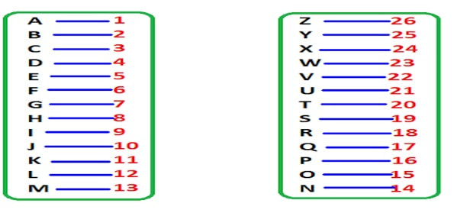
Letter Series:
Missing Alphabet Series:
Example 1: The missing letter of the series O, R, U, __ is:
A) V B) W C) X D) Y E) Z

Slide 15
Mixed Series:
Example: What will be the next term of the series A1F, B4G, C9H, D16I, ?

Slide 16
Miscellaneous Series:
Example: Find the missing series.
xy _ kx _ zk _ yzk xyz _ _
Explanation:
xyzk/ xyzk/ xyzk/ xyzk/ x
=> zyxkx

Slide 17
Letter Series
7. Find the next term of the series QLF, TOI, WRL, ____
A) ZJF B) ZUO C) ZID D) ZHE
Notes:
Difficulty level: Easy (Compulsory)
Correct Option: B

Slide 18
Letter Series
8. Find the next term of the series MKP, QOT, USX, ____
A) YXG B) ZWB C) YWB D) UZC
Notes:
Difficulty level: Easy
Correct Option: C

Slide 19
Letter Series
9. Find the next term of the series ZA5, Y6B, XC7, W8D, _____
A)E7V B)V2E C) VE5 D) VE9
Notes:
Difficulty level: Moderate (Compulsory)
Correct Option: D
Explanation:- There are three series to look for here. The first letters are alphabetical in reverse: Z, Y, X, W, V. The second letters are in alphabetical order, beginning with A. The number series is as follows: 5, 4, 6, 3, 7.

Slide 20
Letter Series
10. Find the missing term in the series a_bbc_ _a_b_c
A. bcaca B. babac C. acabc D . acabb
Notes:
Difficulty level: Easy (Compulsory)
Option : C
Pattern is : aabbcc

Slide 21
Letter Series
11. Find the missing term in the series xy_x_yxx_y_y
A) xyyx B) xyxy C) xxyy D) xyyy
Notes:
Correct Option: B
Explanation:- Pattern is xy/xxyy/xxxyyy

Slide 22
Ranking Example:In a row of persons, the position of Aparna Nair from the left side of the row is 27th and there are 5 persons after her in the row. Find the total no. of persons in the row? Solution : No. of persons in the row = Position of Aparna from left + No. of persons after Aparna ⇒ Total no. of persons = 27 + 5 = 32

Slide 23
Any Doubts???

